Slide 1
PRESENTATION on Intro to data science
Singam Setty Sai Sumanth
12001822​

Slide 2
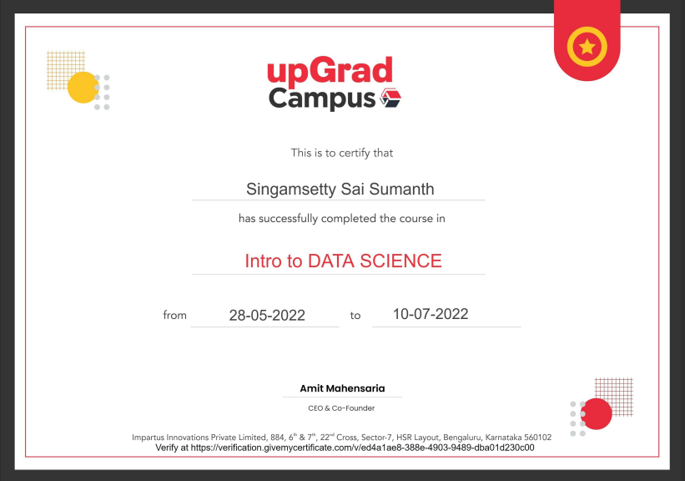

Slide 3
DATA SCIENCE??
Data Science is the area of study which involves extracting insights from vast amounts of data using various scientific methods, Algorithms, and Processes. It helps to discover patterns from the raw data.

Slide 4
AGENDA
Introduction​
​Project Screenshots
​Conclusion​

Slide 5
Introduction
“Introduction to Data Science” is an online specialization course offered by UPGRAD consisting of 4 courses:
Introduction to Excel,
Fundamentals of Python and Libraries,
Data Visualization Using Excel
Statistics for Data Science
This specialization teaches the essential skills for working with large-scale data.

Slide 6
Aim Of The Project
Finding the movies with highest profit
Finding IMDb rating of Top 250
Finding the best top 10 directors
Top 5 Popular Genres
Finding the critic-favorite and audience-favorite actors

Slide 7
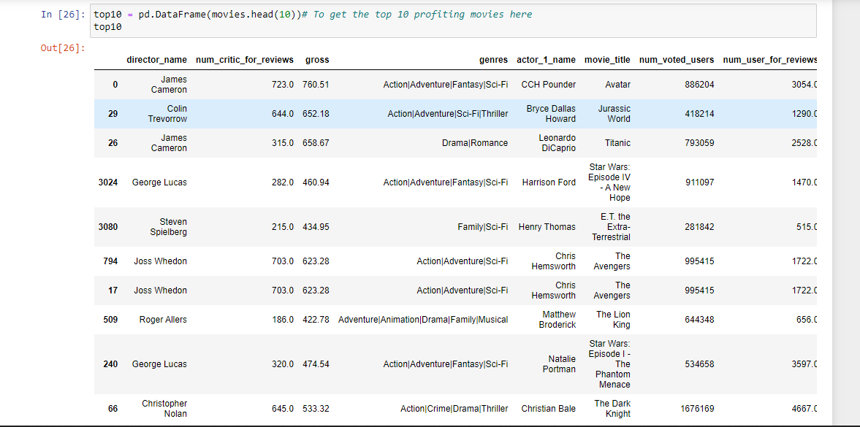
Project Screenshots

Slide 8
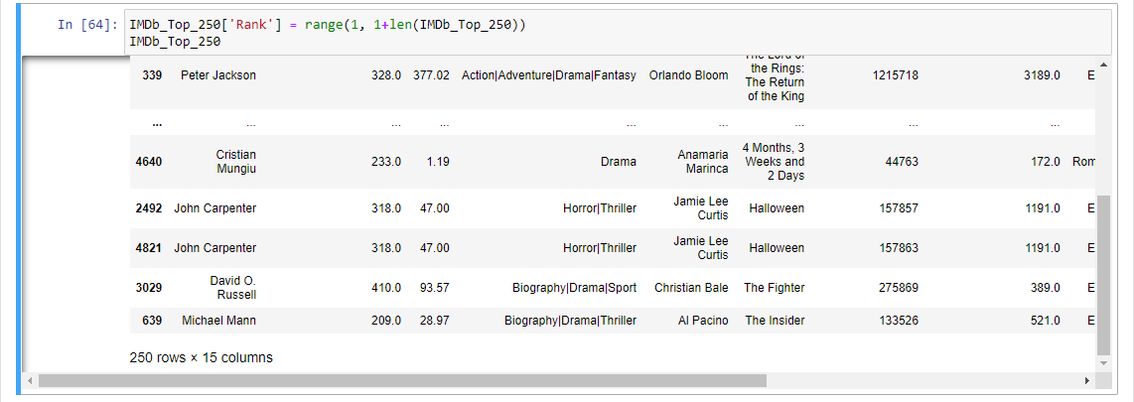
.

Slide 9
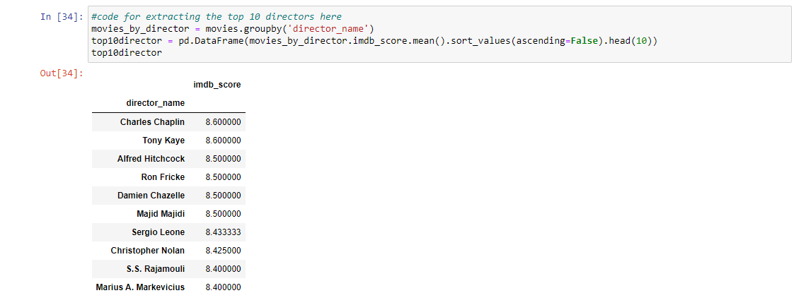
l

Slide 10
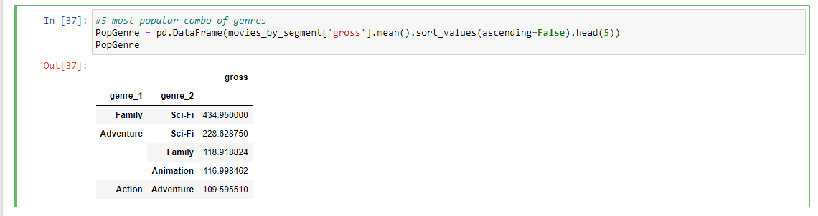
5 Popular Genres

Slide 11
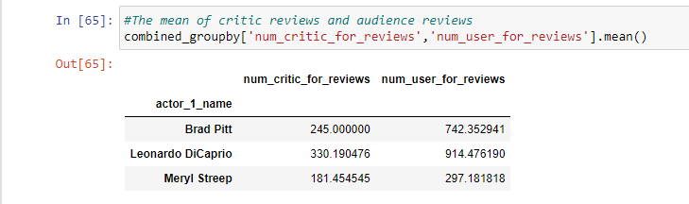
critic-favourite and audience-favourite actors

Slide 12
conclusion
To Conclude the Project, Initially data has been imported and necessary cleaning has been done such as Removing Null values, Drop duplicates etc. On Analyzing the data, The insights that I found are The movies with highest profit, IMDb rating of Top 250, The best top 10 directors, Top 5 Popular Genres, The critic-favorite and audience-favorite actors

Slide 13
THANK YOU
13
Singam Setty Sai Sumanth

